Slide 1
Projects, solutions, partnerships
Introducing the M&P Group.
06/2024

Slide 2
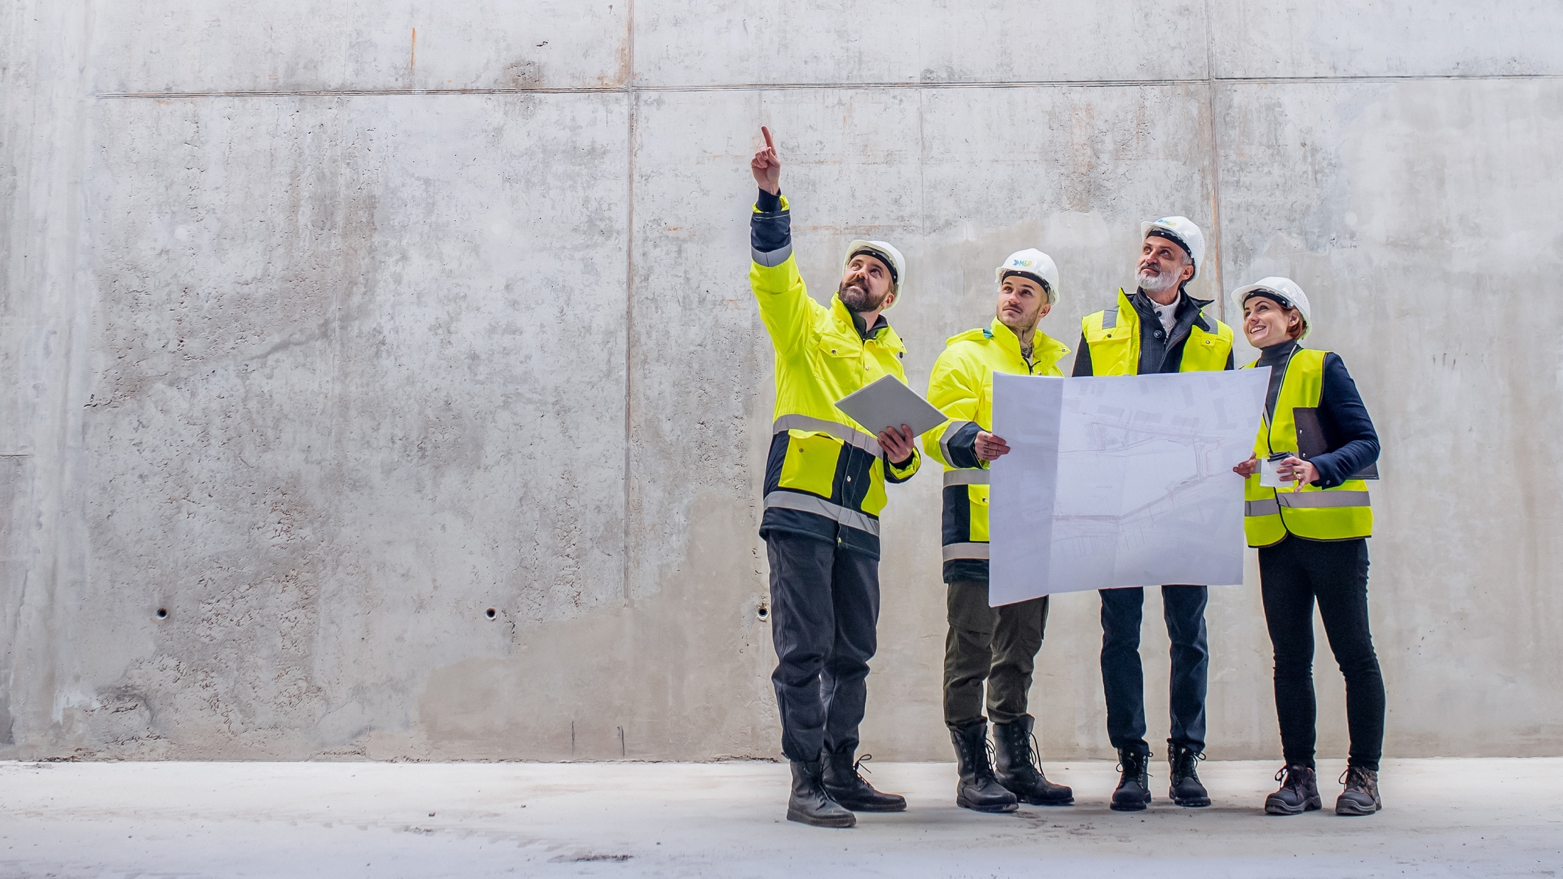
Shaping the future of real estate
Introducing the M&P Group
If you want to drive development forward, you have to be at
the forefront of the action. M&P is an innovation driver in the construction and real estate industry – with a groundbreaking consulting approach that holistically identifies and exploits potential in your company. Get on board with us and benefit from our expertise.

Slide 3




Creating added value
Providing holistic consulting to drive change.
Only a holistic view of a building, with all its potential over its entire life cycle, results in the greatest possible added value. Optimal technical, digital and organisational networking is our goal in every project. In order not to waste any time on the way there, we rely on a unique holistic consulting approach: at M&P, experts from the fields of engineering, energy, IT solutions and consulting work together and beyond the limits of their discipline on future-ready solutions for all areas of the construction and real estate industry.
M&P sees itself as an innovation driver in the construction and real estate industry. As we move forward, we develop sustainable ideas for tomorrow and increase the strength of transformation dynamics in key innovation fields in the industry:
Intelligent engineering design creates innovative infrastructures.
360° energy-efficiency concepts ensure the highest level of sustainability.
Tailored IT solutions drive digital transformation throughout the real estate
life cycle.

Slide 4
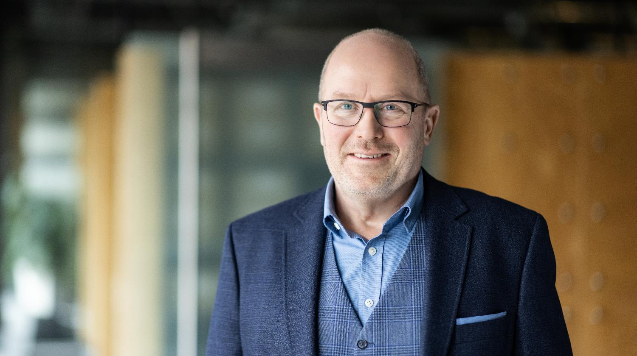
Introducing the M&P Group
‘We are guided by the conviction that an optimal technical, digital and organisational solution provides the greatest added value for real estate!’
Olf Clausen, CEO M&P Group

Slide 5

Introducing the M&P Group
Life cycle partners for the construction
and real estate industry

Slide 6
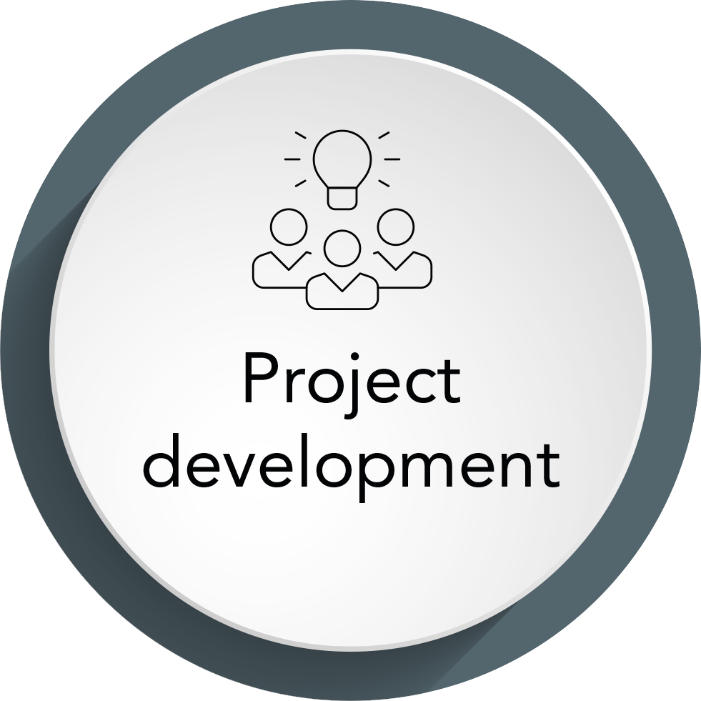
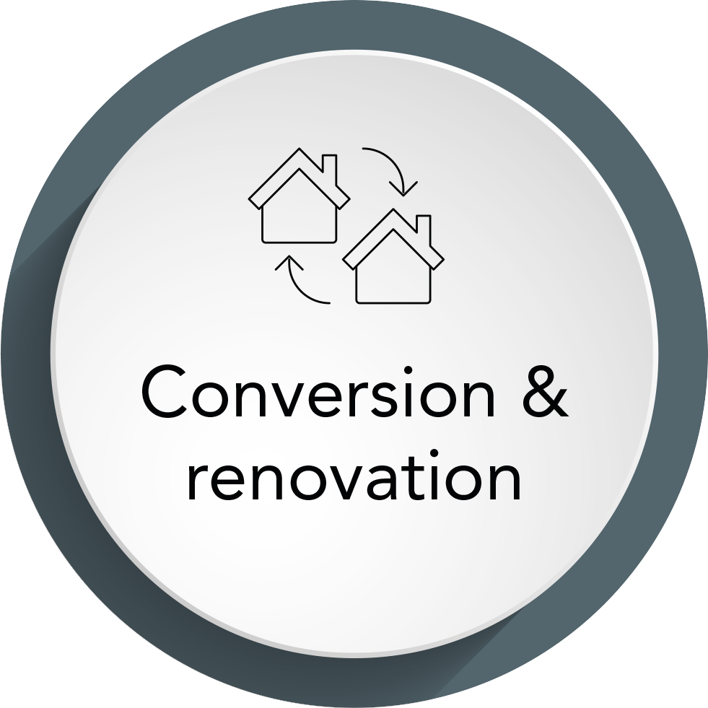

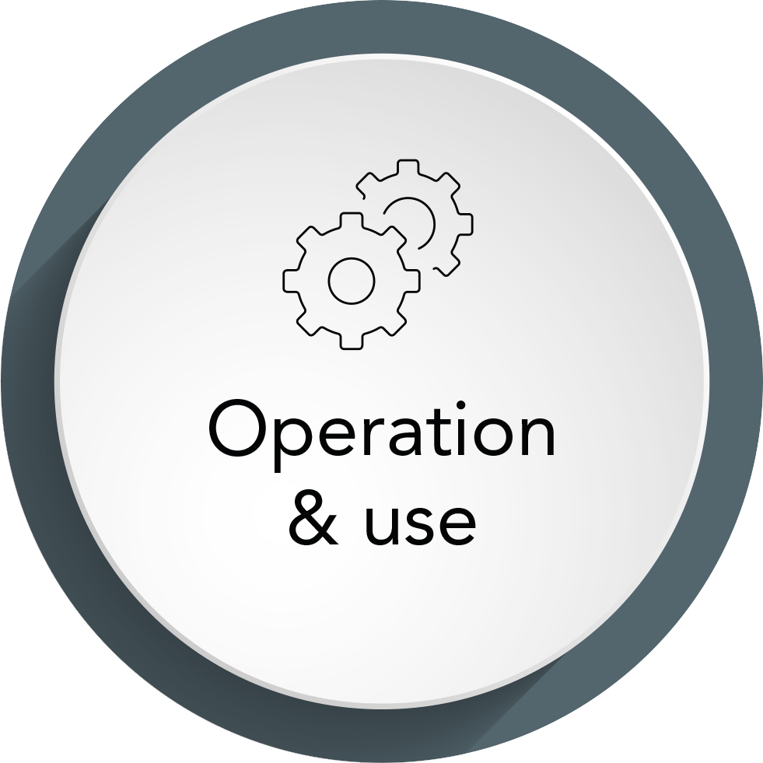
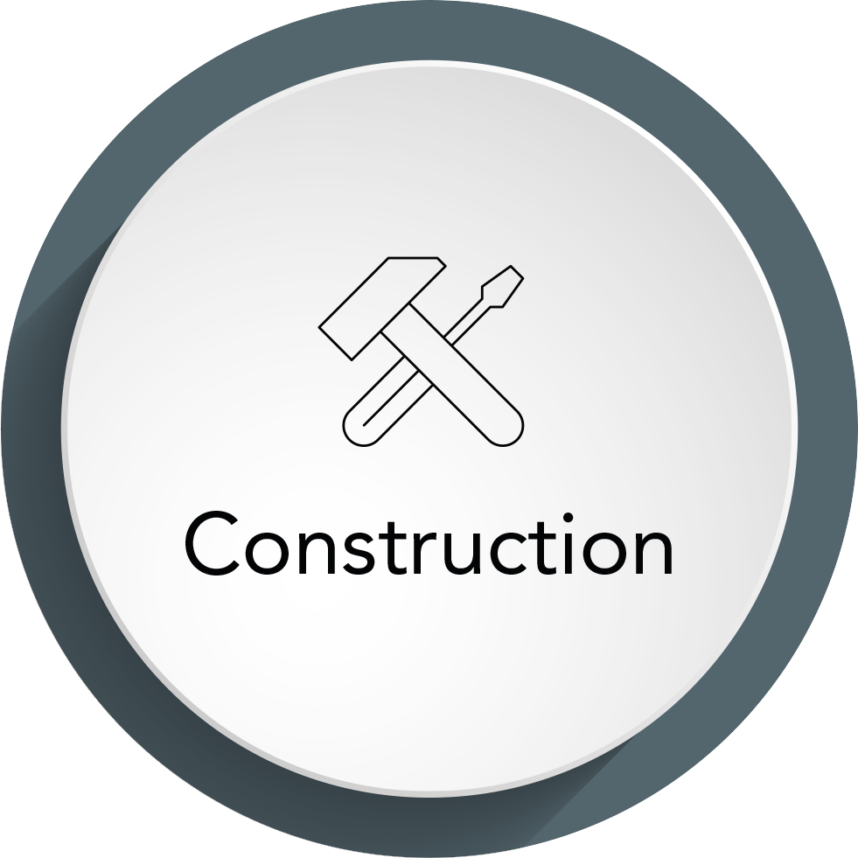
Our holistic solution expertise throughout the entire life cycle of a building makes us the people to get in touch with when it comes to real estate. Our clients include building owners, project developers and asset managers, engineers and architects, general contractors and facility service providers.
More than three decades of successful work provide evidence of our high levels of performance and underline our position as a driver of innovation. We know the industry like the back of our hand. We know its requirements and challenges. Our industry-specific knowledge and holistic consulting create space for change and progress. In every phase of the life of a property. We know what we are doing. And what needs to be done to plan, set up and operate buildings in a future-proof manner.
Get on board with us and benefit from our expertise.

Slide 7

Facts & figures 2024
Introducing the M&P Group
14
Offices
75,7
With 14 locations in Germany and Switzerland, we cover the entire German-speaking region, so we are always close to our clients and their projects.
Million Euro
order backlog EOY
The overall order backlog at the beginning of the financial year 2024.
330
73,5
Million Euro
output
Employees
In 2023, gross operating revenue of € 73.5 million was achieved.
in the business fields of engineering, energy, IT solutions
and Consulting ensure the success of our customers in interdisciplinary, agile and networked structures.

Slide 8
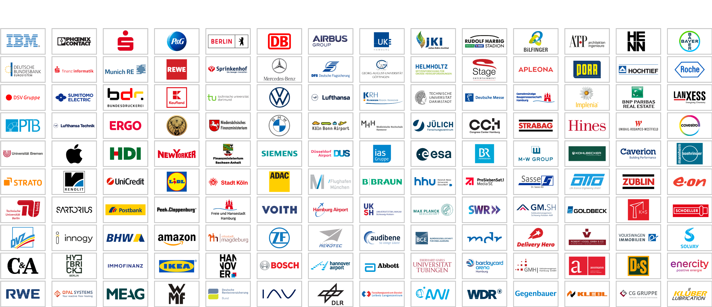
References
Data center
Technology
Finance
Consumer
goods & retail
Public
Automotive
Aeronautics
/aerospace
Health Care
Research
Media & entertainment
Professional services
Real estate
Real estate
Industry

Slide 9


History
How we became who we are.
Introducing the M&P Group
2018
Founding of
M&P Magdeburg
and M&P Essen.
2019
Founding of the technical office of ‘m+p Schweiz AG’ in Basel.
2023
Establishment of a branch office of M&P Dresden in Leipzig.
2024
Founding of the technical office of M&P Braunschweig in Paderborn.
2019
Acquisition of Lessor.
2016
Opening of subsidiaries
in Dresden and Frankfurt.
2018
Joint Venture ‘TGA 360°’
with IB Hornig to expand the
general planning competence.
2019
Sale of the ‘haveldata’
in Brandenburg.
2022
Acquisition of Schuster and Walther Software.
2023
Founding of
‘M&P Dresden’.
2023
Sale of the
M&P Solutions.
2025
2014
Founding of m+p
consulting in Stuttgart.
2009
Founding of m+p consulting Hanse in Hamburg and m+p consulting Rhein-Neckar in Mannheim as well as the m+p academy.
2014
Founding of m+p Schweiz in Wallisellen.
2011
Joint venture Savemaxx
Contracting with Apleona for
energy efficiency projects.
2006
Founding of m+p consulting West in Düsseldorf.
1999
Founding of the IT company m+p business solutions.
1993
Opening of the first
branch – m+p consulting Süd – in Munich.
2014
Opening of subsidiary
Berlin Stahnsdorf.
2012
Participation in BEGIS in Düsseldorf.
2010
Acquisition of haveldata
in Brandenburg.
2007
Participation of
ACS Consulting in Leipzig.
2003
Founding of Savemaxx in
Osnabrück (Melle).
1996
Participation of Apleona
(formerly Philip Holzmann AG,
later Bilfinger Berger HSG FM) in the M&P Group.
1989
Founding of an engineering
company by Prof. Dr. Kurt Müller and Olf Clausen on 05.05.1989.

Slide 10
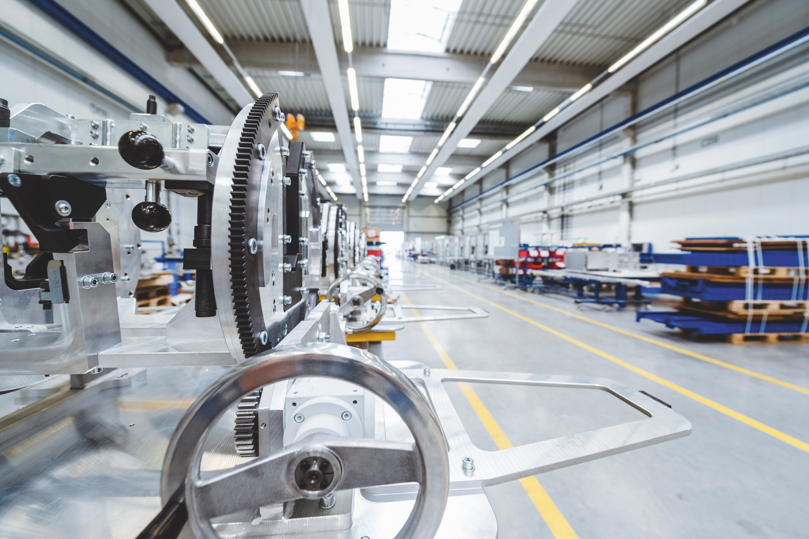
With digital expertise for innovative infrastructures
Introducing the M&P Group
ENGINEERING
Whether it is a new construction or a refurbishment, energy optimisation or a large-scale international project: the engineers from M&P offer a complete range of services as general technical planners in all service phases of the German regulation on the fees for services rendered by architects and engineers (HOAI). Our solution expertise comes from a single source and is geared towards the future. Tomorrow’s buildings are based on smart development. In the real estate and construction industry, M&P is state of the art: we accompany construction projects from the start of the project to the operational phase with comprehensive technical know-how, the latest IT tools and model-based planning methods based on BIM (building information modelling). Our digitised planning expertise takes process efficiency to the next level in each stage of the project and makes progress immediately visible. A new dimension in life cycle engineering – for all trades in cost group 400.
TGA general planning
Systems ­engineering
BIM & Digital planning
Specialist engineering & Prototyping
Lean and agile project management
Building digitisation
Joint Venture TGA 360°
Quality assurance
Master planning
Commissioning & Simulation
Green-Building-Design
Technical-Due-Diligence

Slide 11

Harmonising energy and efficiency
Introducing the M&P Group
ENERGY
The transformation of the energy industry is the key to a CO₂-neutral future. The construction and real estate industry is becoming an important player in the energy transition: buildings are still responsible for one third of global greenhouse gas emissions. The high consumption rates create enormous potential for energy efficiency, which M&P makes full use of – over the entire life cycle of a building: from cloud-based potential analysis to tailor-made optimisation concepts and energy-efficiency partnerships: we effectively support you in the implementation of your sustainability strategy!
GEG inspections
Quality assurance
GEG energy certificates
Energy management
Energy transition
Energy efficiency
Energy audit
Energy contracting
Energy analysis
Project development

Slide 12

Lead digital transformation
Introducing the M&P Group
IT SOLUTIONS
Digital transformation is in full swing. It is changing infrastructures, working models and business processes. M&P is the leading digitisation partner in the construction and real estate industry. With the expertise of an industry leader, we develop the roadmap for digital transformation in your company – with ERP, project service and field service solutions. No matter which industry you work in and what specific needs you have: we connect you with the future. On the basis of Microsoft 365 and SAP.
E-Commerce
Controlling
Personalmanagement
ERP
Digitaler Arbeitsplatz
FM für Real Estate
Self Service Portale
Engineers Cloud
CRM
Business Management
Projektmanagement
Consulting & Security

Slide 13

Providing holistic consulting to create scope for action
Introducing the M&P Group
CONSULTING
Modern real estate and facility management combine infrastructures, people, technologies and know-how to create new scope for action – from planning to the operational phase. The success of every transformation is a team effort at M&P: we network ideas from the areas of management consulting, engineering, energy and digitisation to create groundbreaking solution competence. Our optimisation approach is systematic, our results are holistic: top performance in every stage of the life of your property.
Business models
Sourcing
Organisational consulting
Quality assurance
Save-to-Perform
Project management
Operating concepts
BIM & Digitisation

Slide 14












TGA general planning
Comprehensive planning expertise from a single source.
Sanitary engineering
Heating supply
Ventilation technology
Cooling supply
Holistic, efficient, pioneering: for more than 30 years, M&P has been acting as TGA general planner for all trades in cost group 400–480 in the construction and real estate industry.
With unparalleled solution expertise and a comprehensive service portfolio, we develop future-proof concepts that are precisely tailored to the needs of your technical systems.
Model-based planning methods such as BIM modelling and applied Lean construction management ensure systematic process optimisation and cost-optimised high-quality implementation in all HOAI phases:
Electrical engineering
Information and
telecommunications
technology
Conveyor technology
Kitchen appliances
Fire protection
technology
Building automation
and digitisation
System integration
and commissioning
Dynamic simulation
BIM design method + Lean project management method

Slide 15














Thank you
Memberships

